Slide 1
Generative Models vs Traditional AI-Driven Anomaly Detection in Large-Scale System Logs
A Comparative Study
Muhammad Asad Mahmood Khan [Roll No: 243260] Program: MSAI (Fall 2024) Air University, Department of Creative Technologies

Slide 2
Presentation Agenda
1. Introduction
2. Literature Review (Traditional ML & Deep Learning)
3. Problem Statement & Research Gap
4. Research Questions & Objectives
6. Methodology (5-Phase Framework)
7. Results
8. Conclusion & Future Work

Slide 3
1. Introduction
What are system logs, why they are generated, and what they record
What are System Logs?
Records of events and activities occurring in an operating system, server, network device, or application.
They act like a “diary” of the computer, recording important events such as logins, errors, service starts, and device connections.
Typical information includes timestamps, usernames, IP addresses, processes, event types, and success/failure status.
Why are they generated?
Troubleshooting — identify errors and failures.
Security — detect suspicious or unauthorized activity.
Monitoring — observe system and service health.
Auditing — track important changes and actions.
Investigation — reconstruct events after an incident.
Common Types
Authentication logs — successful/failed logins and password changes.
Application logs — application starts, errors, exceptions, and transacations.
Operating-system logs — boot, shutdown, service, and hardware events.
Security logs — suspicious activity, permission changes, malware, and firewall events.
Network logs — connections, blocked traffic, DNS, VPN, and firewall activity.
Example
20:15:42 SSH Failed password user=asad source=192.168.1.50
Key idea: Logs help people and security tools understand what happened, when it happened, and often why.

Slide 4
Log Anomalies
Unusual, unexpected, or abnormal events and patterns found in system logs.
Common Types
• Frequency anomaly — too many or too few events
• Time anomaly — activity at an unusual time
• Pattern anomaly — unexpected sequence of events
• Volume anomaly — unusually large log/data volume
• User behavior anomaly — activity differs from normal
Other Important Types
• IP/Location anomaly — unusual source or location
• Error anomaly — sudden increase in errors
• Security anomaly — activity suggesting an attack
• Resource anomaly — unusual CPU, memory, or disk use
• Configuration anomaly — unexpected system changes
Example: Possible Brute-Force Attack
• 03:12 Failed login → 03:13 Failed login → 03:14 Failed login → 03:15 Successful login
Log anomalies help detect system failures, unusual behavior, and potential cybersecurity threats.

Slide 5
Why is log anomaly detection important?
Detecting abnormal log activity helps organizations identify threats and system problems early.
Security & Early Warning
• Detects brute-force attacks and unauthorized access
• Identifies malware and suspicious user behavior
• Provides early warning before damage increases
• Enables faster security response
Operations & Investigation
• Finds errors, crashes, and service failures
• Reduces manual monitoring of large log volumes
• Shows what happened, when, and what was affected
• Supports incident investigation and auditing
Simple Example
• Normal: 10 failed logins/day → Anomaly: 500 failed logins in 5 minutes → Alert & investigation
Early anomaly detection helps organizations respond faster, reduce risk, and prevent serious damage.

Slide 6
2. Literature Review (Traditional ML & Deep Learning)
Paper Name & Citation | Dataset | Anomaly | Mode (Model/Method) | Result (Performance)
Detecting Large-Scale System Problems... (Xu et al., 2009) | HDFS, Darkstar | Binary | PCA (Principal Component Analysis) | F1: ~0.93
Mining Invariants from Console Logs... (Lou et al., 2010) | Hadoop, HDFS | Binary | Invariant Mining (Unsupervised) | Recall: ~0.90
Experience Report: System Log Analysis... (He et al., 2016) | HDFS, BGL | Binary | Log Clustering, PCA, IM | F1: 0.88 - 0.95
Isolation Forest (Applied to Logs) (Liu et al., 2008) | HDFS, BGL | Binary | iForest (Tree-based Ensemble) | F1: ~0.73
DeepLog: Anomaly Detection... (Du et al., 2017) | HDFS, OpenStack | Binary | LSTM (Next-Key Prediction) | F1: 0.96
LogAnomaly: Unsupervised Detection... (Meng et al., 2019) | HDFS, BGL | Binary | LSTM + Template2Vec (Attention) | F1: 0.97
Robust Log-based Anomaly Detection... (Zhang et al., 2019) | HDFS, BGL | Binary | Bi-LSTM + Attention | F1: ~0.98

Slide 7
Literature Review (Generative AI)
Paper Name & Citation | Dataset | Anomaly | Mode (Model/Method) | Result (Performance)
LogBERT: Log Anomaly Detection via BERT (Guo et al., 2021) | HDFS, BGL | Binary | BERT (Masked Language Model) | F1: 0.993
LogGAN: A Generative Adversarial Network... (Xia et al., 2020) | HDFS, BGL | Binary | LSTM-GAN (Generator-Discriminator) | F1: ~0.95
LogPrompt: Prompt Engineering... (Liu et al., 2023) | HDFS, BGL | Binary | LLM Prompting (ChatGPT/GPT-4) | F1: ~0.98+
LSTM-Based VAE-GAN for Time-Series... (Xu et al., 2020) | HDFS (Time Series) | Binary | VAE-GAN (Variational Autoencoder) | F1: ~0.94
Mask-Guided Anomaly Detection (FastLogAD) (Lin et al., 2024) | HDFS, Thunderbird | Binary | Masked Generator (GenAI-based) | F1: ~0.99

Slide 8
3. Problem Statement & Research Gap
The Functional Dichotomy
Brittleness of Supervised ML: Traditional models (SVM, XGBoost) achieve F1 > 0.99 but require rigid manual feature extraction. They fail entirely when log syntax or system architectures change.
Inefficacy of Unsupervised Baselines: Traditional unsupervised methods (e.g., Isolation Forest) struggle with sequential dependencies, yielding poor detection rates on unknown errors.
The Critical Research Gap
Most existing literature benchmarks models on a single dataset (usually HDFS) in isolation. There is no proven, unified framework combining supervised accuracy with generalized, unsupervised flexibility across diverse architectures.

Slide 9
4. Research Questions & Objectives
Research Questions (RQs)
How Gen AI generalize better than Traditional ML across systems?
Could Gen AI outperform traditional unsupervised methods for unknown anomalies?
Research Objectives
Benchmark Traditional ML: Evaluate limits of XGBoost/SVM and Isolation Forest on HDFS.
Evaluate Deep Learning: Implement discriminative models (LSTM, GRU) on temporal sequences.
Validate Generative AI: Develop normal-only models (LSTM-AE, VAE) to detect zero-day errors.
Tri-Fold Comparative Study: Produce a cross-platform matrix across HDFS, Spark, and Hadoop.

Slide 10
5. Methodology (5-Phase Framework)
Multi-Source Dataset Collection: Aggregating logs from HDFS (block data), Spark (task execution), and Hadoop setups.
Log Preprocessing & Parsing: Utilizing Drain Parser for template extraction, event ID mapping, and timestamp normalization.
Comparative Model Training: Executing 3 distinct pipelines: Traditional ML, Deep Learning, and Generative Al.
Cross-Platform Testing: Applying an 80/20 train-test split; evaluating models independently on unseen architectures.
Comparative Analysis: Evaluating quantitative metrics alongside functional automation and zero-day capabilities.

Slide 11
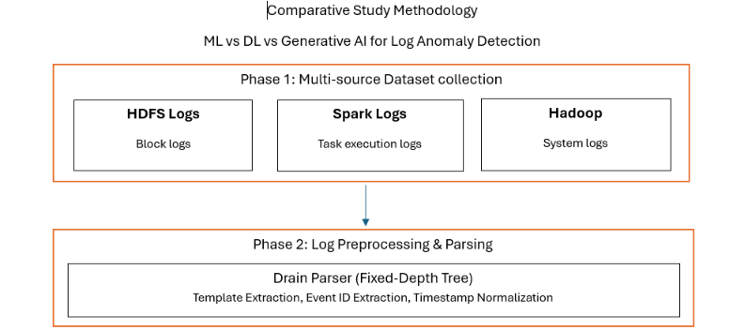
Methodology

Slide 12
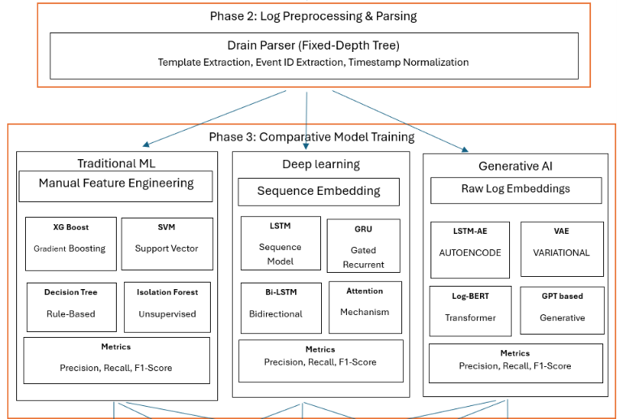
Methodology

Slide 13
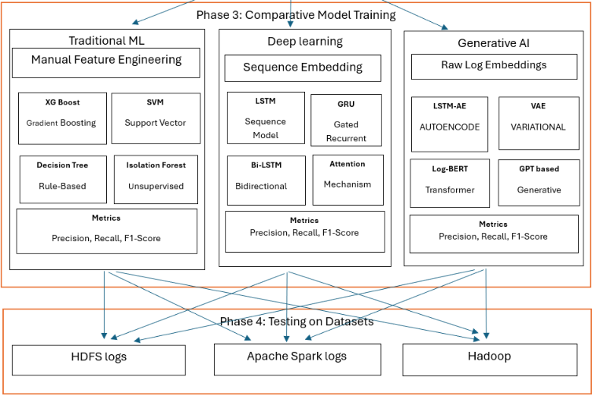
Methodology

Slide 14
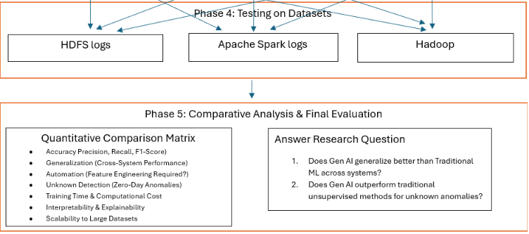
Methodology

Slide 15
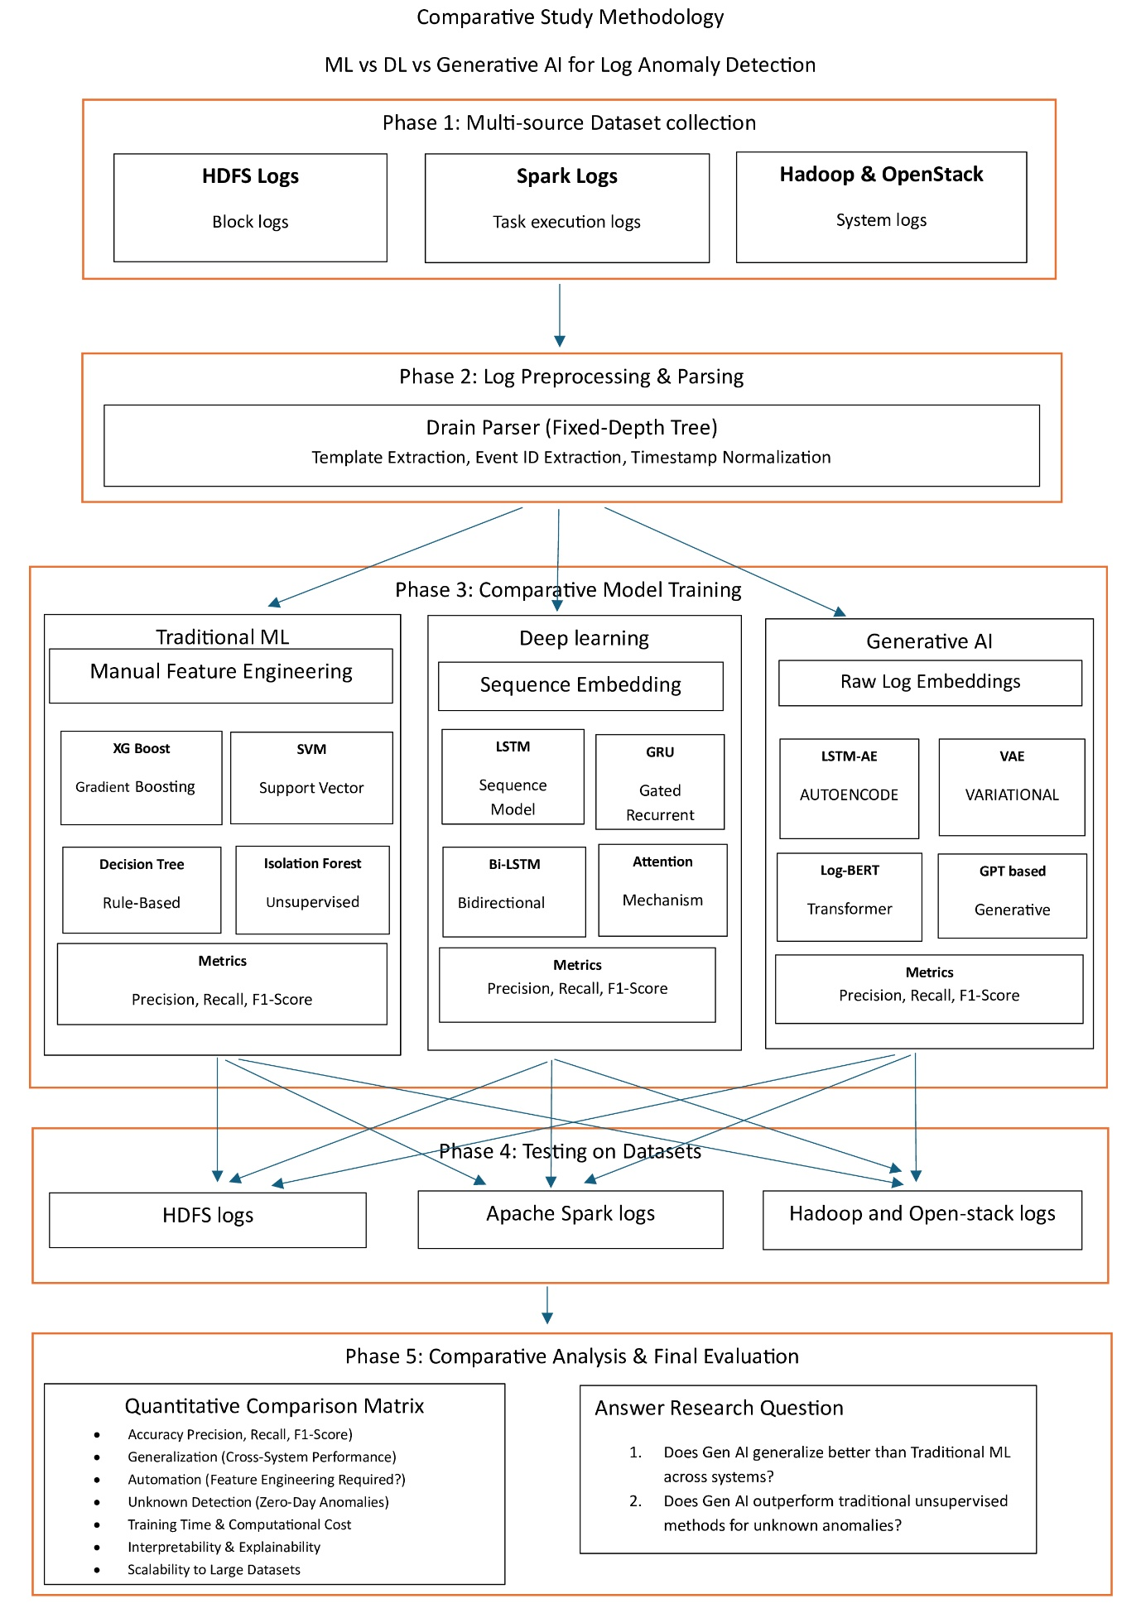

Slide 16



Dataset Strategy
HDFS v1
Apache Spark
Hadoop / OpenStack
The "Gold Standard"
The Generalization Test
Broader Validation
Contains over 575,000 block logs with labeled "Normal" and "BlockCorrelation" failures. Used to train and stringently benchmark all
initial model types.
Contains 1.6million highly complex, overlapping task execution logs. Used exclusively to evaluate inter-system transfer learning and architectural robustness.
393,433 Broader system-level logs utilized for final cross-platform validation to ensure selected models do not memorize application-specific syntaxes.

Slide 17
Spark Dataset: Challenges
RAM Crash
Processing 33 Million rows (5GB CSV) crashed two distinct Colab sessions instantly. Solution: Implemented chunked processing, writing 200 files at once directly to CSV to bypass memory limits.
Extreme Imbalance
The dataset contained only 0.14% anomalies. Models defaulted to predicting "Normal" for 99.86% accuracy without learning. Solution: Applied SMOTE to increase anomalies from 1,820 to 1,327,644
Compute Limits
Training generative models quickly exhausted Google Colab GPU limits. Solution: Utilized multiple school accounts and meticulously organized pathways on Git for seamless environment swapping.

Slide 18
Hadoop Dataset: Challenges
Ulta (Reverse) Class Imbalance
Unlike Spark, 93.57% of the Hadoop dataset consisted of anomalies. If left untreated, the models would simply learn to output "anomaly" continuously to achieve high accuracy. The Solution: We utilized SMOTE combined with targeted data pollution, fixing the ratio artificially at 0.5 to force the models to learn true distinguishing features.
Model Timeout Issues
Traditional algorithms struggled with the dimensionality and scale of the Hadoop logs. The standard One-Class SVM ran for over 29 minutes per iteration and would consistently fail to complete. The Solution: We swapped the traditional implementation for SGDOneClassSVM. This Stochastic Gradient Descent variant completed the exact same task 100x faster.

Slide 19
Experimental Setting (Comparative Pipelines)
Pipeline 1: Traditional ML
Pipeline 2: Deep Learning
Pipeline 3: Generative AI
Input: Parsed Log Templates.
Feature Eng: Manual TF-IDF & Event Count Matrices.
Models: XGBoost, SVM, Random Forest, Isolation Forest.
Hyperparameters: Base Estimators (Trees): 100, Max Depth: 6 Training Parameters: Learning Rate: 0.1, Subsample: 0.8 Iterations (Boosting Rounds): 100
Input: Raw Log Embeddings.
Method: Unsupervised. Learns "normal" distribution only; flags deviations.
Models: LSTM-Autoencoder, VAE, GAN.
Network Architecture: Encoder Layers: 3, Latent Space: 1, Decoder Layers: 3 Training Parameters: Epochs: 100, Batch Size: 128 Iterations: 10,372
Input: Tokenized Log Sequences.
Method: Supervised learning on temporal execution paths.
Models: LSTM, GRU, CNN, Bi-LSTM.
Network Architecture:
Input Layers: 1, Hidden Layers: 3, Output Layers: 1
Training Parameters:
Epochs: 100, Batch Size: 128
Iterations: 10,372

Slide 20


Deconstructing Metrics
Precision
Precision measures how many of the model's positive predictions were actually correct.
Formula
Use case: Important when false positives are costly, such as in email spam detection.
Recall
Recall measures how many of the actual positive cases the model managed to find.
Formula:
Use case: Important when missing a positive case is dangerous, such as in medical testing.

Slide 21

Deconstructing Metrics
F1 Score
The F1 score is the harmonic mean of precision and recall, combining both into a single score.
Formula:
Use case: Useful when you need a balance between precision and recall, especially with imbalanced datasets.

Slide 22
Results: HDFS Baseline Evaluation
Testing completed on 115,013 holdout instances (111,645 normal / 3,368 anomalies).
Model | Category | Precision | Recall | F1-Score | ROC-AUC
XGBoost | Traditional ML (Sup) | 99.85% | 99.97% | 99.91% | --
SVM | Traditional ML (Sup) | 96.34% | 99.94% | 98.11% | --
LSTM | Deep Learning (Sup) | 98.08% | 99.88% | 98.97% | 100%
LSTM-AE | Generative (Unsup) | 72.32% | 88.18% | 79.46% | 99.64%
VAE | Generative (Unsup) | 69.44% | 74.29% | 71.78% | 98.76%

Slide 23


Results: Spark & Hadoop Evaluation
Apache Spark Logs
Hadoop Logs
•
Traditional ML: Isolation forest achieved ROC-AUC 0.95, but F1 was only 0.04. Random Forest peaked at F1 0.44.
•
Traditional ML: Random Forest achieved perfect metrics (F1 1.00).
•
Deep Learning: CNN recovered performance (F1 0.91).
•
Deep Learning: CNN achieved Recall 1.00 but Precision 0.09 (F1 0.16).
•
Generative AI: LSTM-AE dropped relative to HDFS, achieving F1 0.45.
•
Generative AI: LSTM-AE generated 16,562 False Positives (F1 0.05).

Slide 24
Overall Synthesis Matrix
Model | Category | HDFS F1 | Spark F1 | Hadoop F1
XGBoost | Traditional ML (Supervised) | 0.9991 | - | -
SVM | Traditional ML (Supervised) | 0.9811 | - | -
Random Forest | Traditional ML (Supervised) | - | 0.44 | 1
LSTM | Deep Learning (Supervised) | 0.9897 | - | -
GRU | Deep Learning (Supervised) | 0.9899 | - | -
CNN Classifier | Deep Learning (Supervised) | - | 0.16 | 0.91
Isolation Forest | Traditional ML (Unsupervised) | - | 0.04 | 0.6
One-Class SVM | Traditional ML (Unsupervised) | - | 0 | 0.32
LSTM Autoencoder | Generative / Unsupervised DL | 0.7946 | 0.05 | 0.45
VAE / LSTM-VAE | Generative | 0.7178 | 0.01 | 0.12
GAN | Generative | - | 0.01 | 0.03
Notes:
Random Forest 1.0 Anomaly
Hadoop labels were assigned per application, not per log line. The dataset features app_id and container_id were directly linked to these application labels.
Random Forest achieved 1.0 F1 by memorizing the app_id mapping, bypassing actual log pattern analysis. This textbook Feature Leakage exposes a dataset limitation, not true model performance.

Slide 25
Discussion On Results (Key Takeaways)
1. The "HDFS Illusion”
Nearly all evaluated models work exceptionally well on structured HDFS datasets (F1 > 90%). This creates a false sense of security in the literature, making anomaly detection appear artificially solved.
2. The "Spark Reality Check"
Complex, asynchronously overlapping Spark logs break almost every evaluated model (F1 < 0.50). This proves a severe lack of true functional transferability in current supervised paradigms.
3. The "Generative Struggle”
Generative models successfully eliminate manual feature engineering and identify zero-day anomalies via strong ROC-AUC. However, they are highly noise-sensitive, leading to massive false positive rates on dynamic systems.

Slide 26
Generative Model Failures
GANs: Structural Mismatch
GANs require highly diverse, dynamic data to function. Log data, however, is rigidly structured and repetitive. This leads directly to Mode Collapse—the GAN simply generates one specific type of fake data over and over. Analogy: A GAN is like a creative artist tasked with spotting accounting fraud. It fundamentally isn't designed for the job.
VAEs: Blurry Reconstruction
Variational Autoencoders produce "blurry" reconstructions by design. Because they generalize, the fine, crucial details in anomalous log lines are completely lost, making the reconstruction error between normal and anomalous logs indistinguishable. Analogy: A VAE is like a cheap photocopier that blurs both a perfectly normal page and a torn page alike.

Slide 27
Thesis Core Finding and My Contribution
Supervised > Unsupervised > Generative
Consistent Hierarchy Across All Datasets
Despite removing the need for manual feature engineering, Generative models are significantly inferior to traditional supervised models for detecting anomalies in large-scale system logs due to structural mismatches and noise sensitivity.
My Contributions
Developed a comprehensive 5-phase comparative framework benchmarking across diverse architectures (HDFS, Spark, Hadoop).
Successfully solved extreme class imbalance (93.57% vs 0.14%) via SMOTE and targeted data pollution.
Proved the functional limitations of Generative AI vs Traditional ML, bridging a critical gap in current cybersecurity literature.

Slide 28
Research Questions Answers
How Gen AI generalize better than Traditional ML across systems?
Generative AI theoretically adapts better to new systems because it skips manual feature engineering—a rigid process that breaks when system formats change. Instead, it learns what "normal" activity looks like to automatically catch unknown, zero-day errors. However, real-world testing proves that Generative AI is too sensitive to background noise. On complex systems like Apache Spark, it gets confused and generates too many false alarms, making traditional supervised models much more reliable in practice.
Could Gen AI outperform traditional unsupervised methods for unknown anomalies?
Generative AI can successfully identify zero-day (unknown) anomalies, achieving strong ROC-AUC scores and providing a valuable baseline through normal-only training. However, it produces massive false positive rates, meaning its overall F1-score is lower, limiting its standalone production readiness.

Slide 29
7. Conclusion & Future Work
Future Work
Dynamic Thresholding:
Implementing Extreme Value Theory (EVT) to adjust reconstruction thresholds and reduce false positives.
Concept Drift Mitigation:
Online learning to adapt to evolving log formats in real-time.
Hybrid Frameworks:
Developing neuro-symbolic models combining ensemble precision with generative semantic understanding.
Conclusion (The Trade-Off)
Traditional ML:
Near-perfect on structured data, but entirely brittle and requires manual engineering.
Supervised DL:
Removes manual extraction but remains highly volatile on noisy logs (e.g., Spark).
Generative Al:
Provides a valuable zero-day baseline due to normal-only training, but low raw F1 limits standalone production readiness.

Slide 30
Questions & Discussion
Thank you for your attention.

